Slide 1
Genomic Imprinting
Phenotypic variation depending strictly on the parental origin of the chromosome carrying a particular gene.
Different from mutation because imprint can be reversed in succeeding generations.
Thought to occur before or during gamete formation.

Slide 2
In the 1980s, biologists began to manipulate the pronuclei of mouse eggs and sperm.
When an egg nucleus and a sperm nucleus where transplanted into an enucleated egg, and the zygote is implanted into a surrogate mother, the zygote developes into a viable mouse.
Gynogenetic zygotes are produced when two egg nuclei are transplanted into an enucleated egg. When the zygote is implanted into a surrogate mother, the embryo dies.
Androgenetic zygotes are produced when two sperm nuclei where transplanted into an enucleated egg. When the zygote is implanted into a surrogate mother, the embryo dies.

Slide 3
Gynogenetic and androgenetic zygotes die because of genomic imprinting
Embryos derived from two egg pronuclei die because of maternal imprinting: certain genes inherited from the mother are transcriptionally silent (imprinted).
The expression of these silenced genes are essential for development. If they are not expressed, the embryo dies.
Gynogenetic
A
B
A
B
A
B
A
B
A
B
A
B
nucleus
nucleus
nucleus
zygote
zygote
egg

Slide 4
Gynogenetic and androgenetic zygotes die because of genomic imprinting
Embryos derived from two sperm pronuclei die because of paternal imprinting: certain gene inherited from the father are transcriptionally silent.
Androgenetic
A
B
A
B
A
B
A
B
A
B
A
B
nucleus
nucleus
nucleus
zygote
zygote
egg

Slide 5
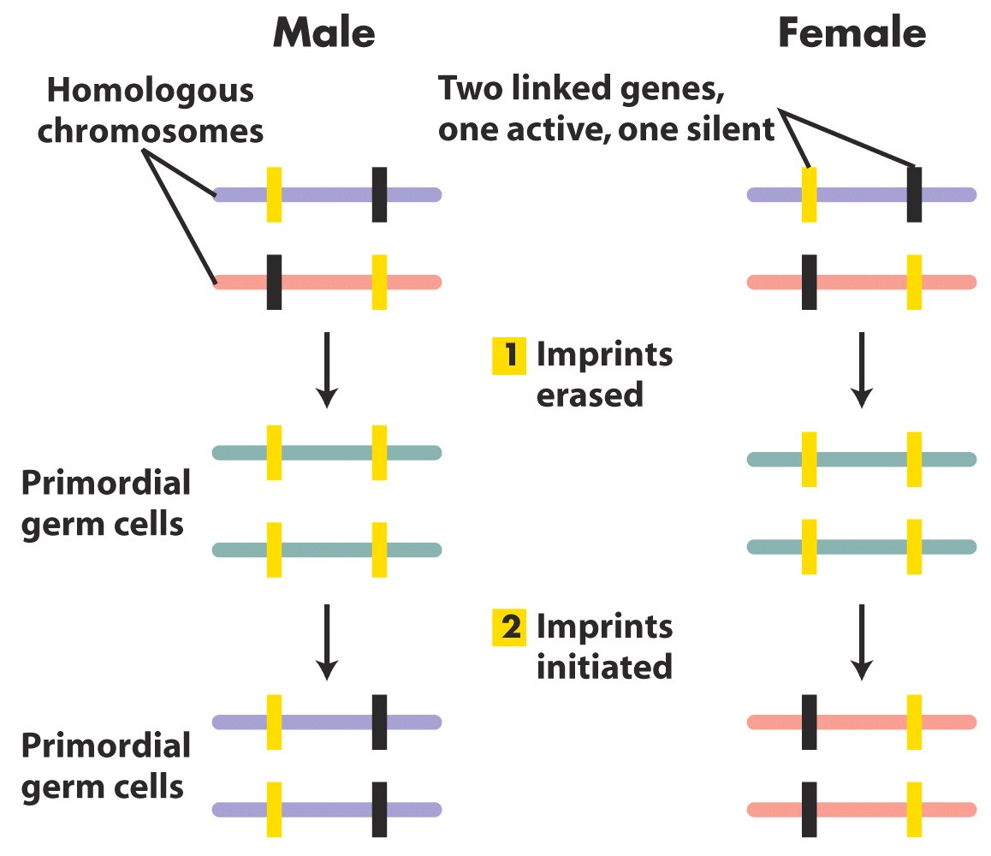
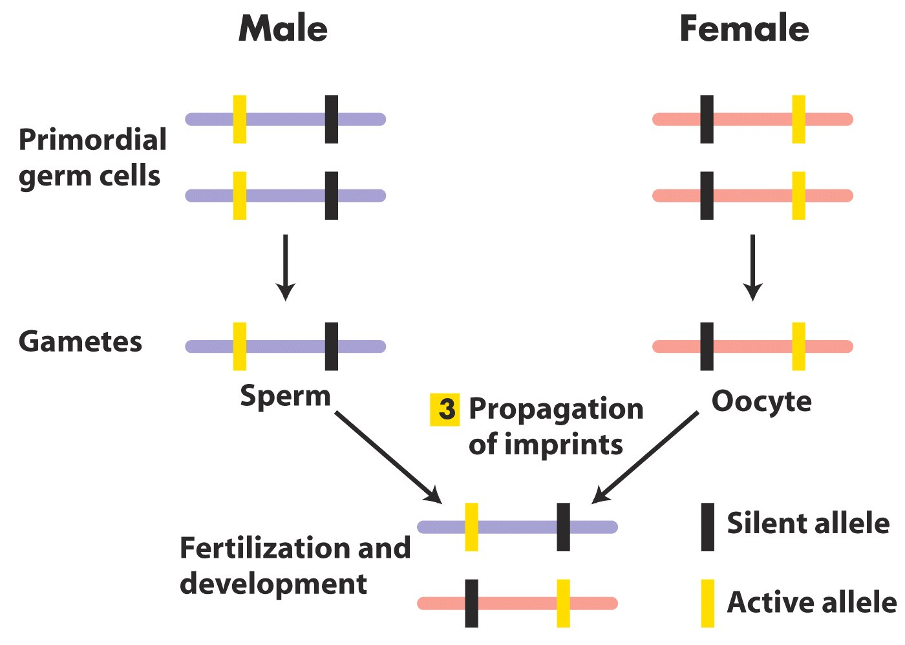

Slide 6
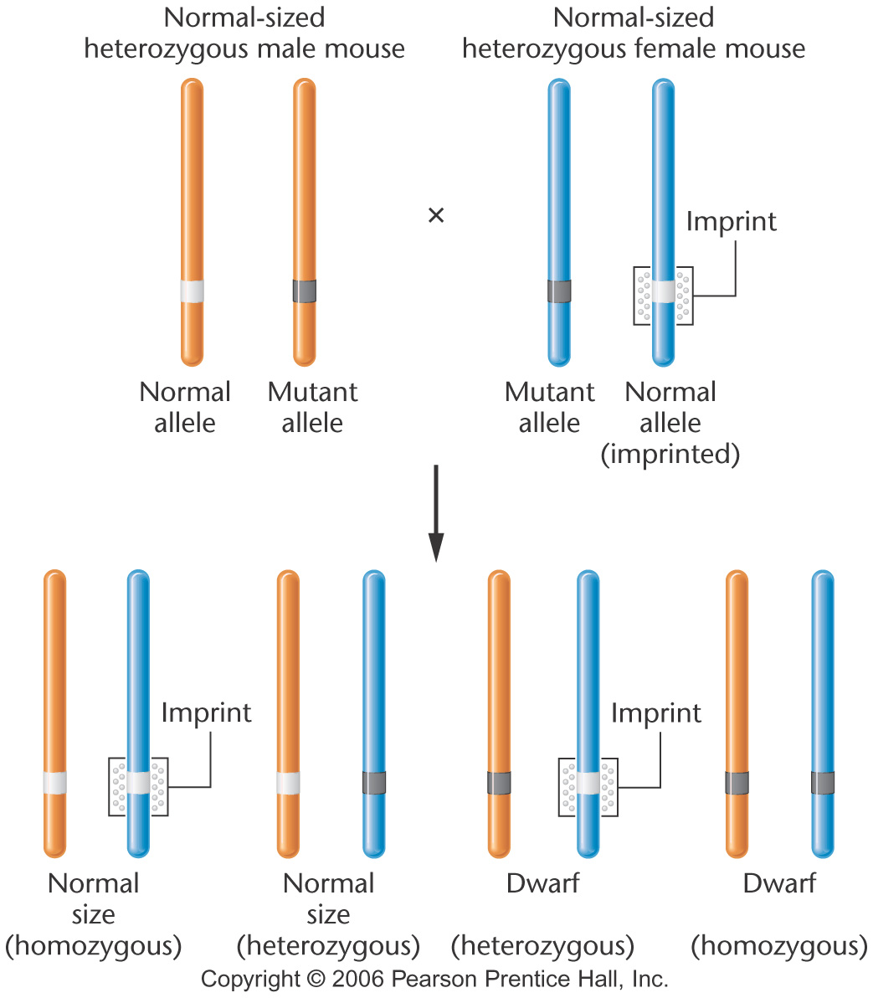
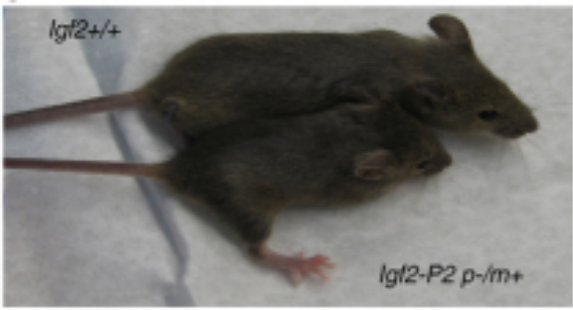

Notes:
Figure 4-19 The effect of imprinting on the mouse Igf2 gene, which produces dwarf mice in the homozygous condition. Heterozygous offspring that receive the normal allele from their father are normal in size. Heterozygotes that receive the normal allele from their mother, which has been imprinted, are dwarf.

Slide 7
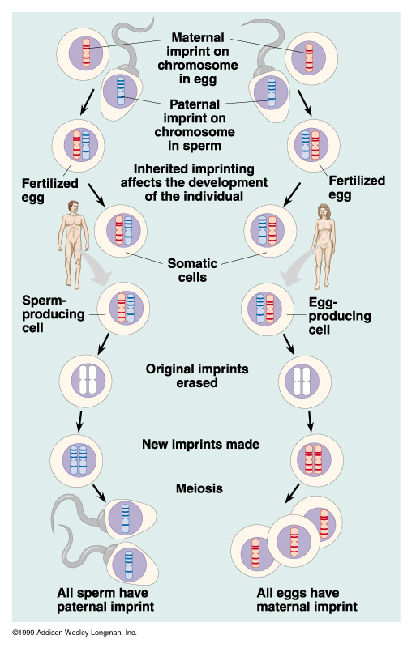
Imprint establishment and propagation
Imprint must be maintained in somatic cell division
Imprint must be erasable in germline when transmitted through opposite sex

Slide 8
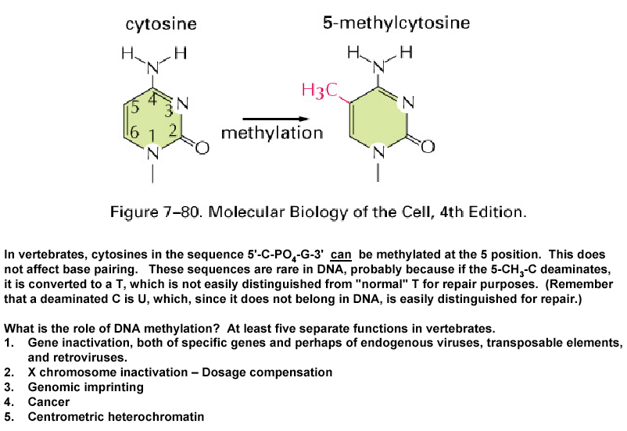
Genomic Imprinting
Regions of chromosome are imprinted
Involves DNA methylation (addition of a methyl group to cytosine)

Slide 9
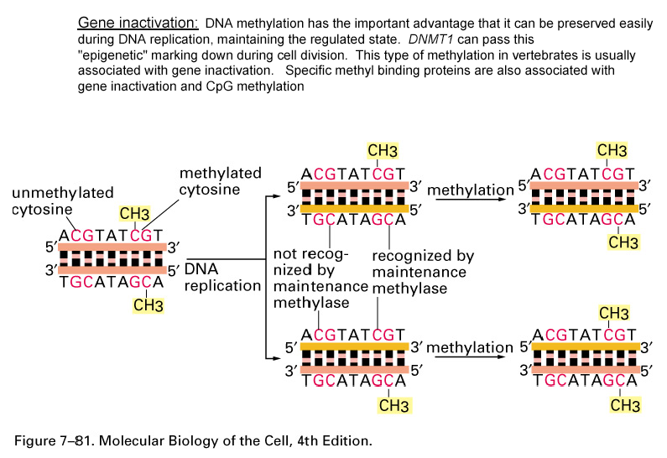

Slide 10
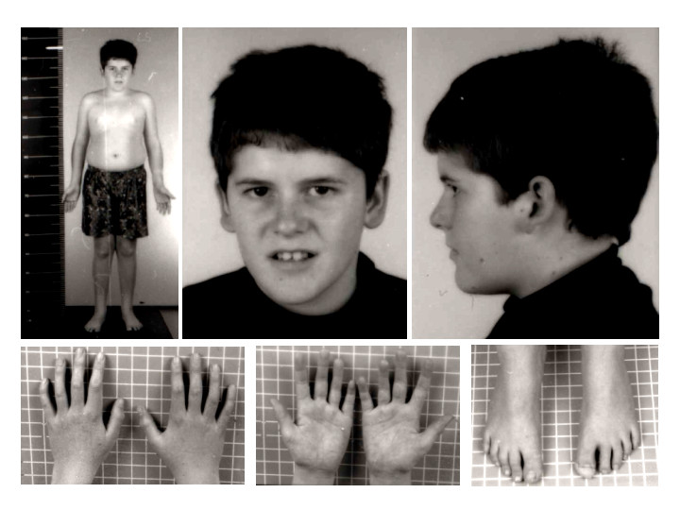
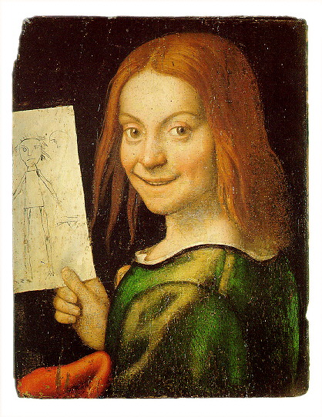
Prader-Willi syndrome
Angelman syndrome

Slide 11
Imprinting in Human: Prader-Willi syndrome
The gene is maternally imprinted
Mother
Father
Chr. 15
x
and
Affected individual

Slide 12
Imprinting in Human: Angelman syndrome
The gene is paternally imprinted
Mother
Father
Chr. 15
x
and
Affected individual

